Slide 1
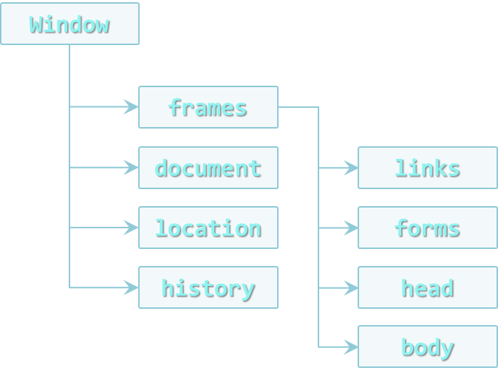

DOM Operations
Creating Dynamic Pages
Doncho Minkov
Senior Technical Trainer
http://minkov.it
Telerik Software Academy
http://academy.telerik.com

Slide 2
Table of Contents
Traversing the DOM
Parents, Children and Siblings
DOM manipulation
Adding, Removing and Altering Elements
Static and Live NodeLists

Slide 3
DOM Elements

Slide 4
DOM Elements
DOM element is a JavaScript object that represents an element from the HTML
Selected using any of the DOM selectors
Created dynamically from code
DOM elements can be changed
This changes are immediately applied to the DOM, and the HTML page
//changes the content of the div
selectedDiv.innerHTML = "changed";
//changes the background of the div to "#456"
selectedDiv.style.background = "#456";
var div = document.createElement("div");

Slide 5
DOM Elements
Live Demo

Slide 6
Traversing the DOM
body
header
div#wrapper
footer
h1#logo
nav #main-nav
h2
nav

Slide 7
Traversing the DOM
DOM elements have properties about their position in the DOM three
Their parent
Their children
Their siblings
Elements before and after the element
These properties can be used to traverse through the DOM

Slide 8
Traversing the DOM (2)
element.parentNode
Returns the direct parent of the element
The parent of document is null
element.childNodes
Returns a nodeList of all the child nodes
Including the text nodes (whitespaces)

Slide 9
Traversing the DOM - Example
var trainersList =
document.getElementsByClassName("trainers-list")[0];
var parent = trainersList.parentNode;
log("parent of trainers-list: " + parent.nodeName + "
with id: " + parent.id);
var children = trainersList.childNodes;
log("elements in trainers-list: " + children.length);
log("element in trainers-list");
for (var i = 0, len = children.length; i < len; i++) {
var subItem = children[i]
log(subItem.nodeName + " content: " +
subItem.innerText);
}

Slide 10
Traversing the DOM
Live Demo

Slide 11
Using the Named Elements in DOM Objects
DOM elements have some properties for special elements inside/near them
First and last child node
The element before/after the current node
The named elements are:
firstChild and lastChild
nextSibling / nextElementSibling
previousSibling / previousElementSibling

Slide 12
Using the Named Elements in DOM Objects
Live Demo

Slide 13
Manipulating the DOM
Making a web page dynamic

Slide 14
Manipulating the DOM
DOM can be manipulated dynamically with JS
HTML elements can be created
HTML elements can be removed
HTML elements can be altered
Change their content
Change their styles
Change their attributes

Slide 15
Creating HTML elements
The document object has a method for creation of HTML elements
document.createElement(elementName)
Returns an object with the corresponding HTML element type
var liElement = document.createElement("li");
console.log(liElement instanceof HTMLLIElement); //true
console.log(liElement instanceof HTMLElement); //true
console.log(liElement instanceof HTMLDivElement); //false

Slide 16
Creating HTML Elements (2)
After an HTML element is created it can be treated as if it was selected from the DOM
When HTML elements are created dynamically they are just JavaScript objects
They are still not in the DOM (the web page)
New HTML elements must be appended to DOM
var studentsList = document.createElement("ul");
var studentLi = document.createElement("li");
studentsList.appendChild(studentLi);
document.body.appendChild(studentsList);

Slide 17
Appending Elements to the DOM
Live Demo

Slide 18
Inserting Elements Before/After Other Element
The DOM API supports inserting a element before or after a specific element
appendChild() inserts the element always at the end of the DOM element
parent.insertBefore(newNode, specificElement)
parent.insertAfter(newNode, specificElement)

Slide 19
Inserting Elements After/Before Other Elements
Live Demo

Slide 20
Removing Elements
Elements can be removed from the DOM
Using element.removeChild(elToRemove)
Pass the element-to-remove to their parent
var trainers = document.getElementsByTagName("ul")[0];
var trainer = trainers.getElementsByTagName("li")[0];
trainers.removeChild(trainer);
//remove a selected element
var selectedElement = //select the element
selectedElement.parentNode.removeChild(selectedElement);

Slide 21
Removing Elements
Live Demo

Slide 22
Altering the Elements
DOM elements can be remove and/or changed
Both the node's children and the node itself
With the DOM API each DOM element node can be altered
Change its properties
Change its appearance

Slide 23
Altering the Elements (2)
Keep in mind that each HTML element is unique in the DOM
If JavaScript changes its appearance or its position, it is still the same element object
<div id="f"><p id="the-p">text</p></div>
<div id="s"></div>
…
var second = document.getElementById("s");
var theP = document.getElementById("the-p");
second.appendChild(theP);
…
//the DOM is:
<div id="f"></div>
<div id="s"><p id="the-p">text</p></div>

Slide 24
Altering HTML Elements
Live Demo

Slide 25
Altering the Style
The style of each HTML element can be altered using JavaScript
Meaning changing the style attribute
The inline styles, not CSS
var div = document.getElementById("content");
div.style.display = "block";
div.style.width = "123px";
Do not forget the unit

Slide 26
Altering HTML Element Style
Live Demo

Slide 27
DOM Optimizations

Slide 28
Appending DOM Elements
The DOM API provides a method for appending DOM elements to a element
The appendChild() method
parentNode.appendChild(node) appends the DOM element node to the DOM element parentNode
If parentNode is appended to the DOM, the node is also appended

Slide 29
Optimizing the Appending of Elements
Appending elements to the DOM is a very slow operation
When an elements is appended to the DOM, the DOM is rendered anew
All newly created elements must be appended together
Here comes the DocumentFragment element
It is a minimal DOM element, with no parent
It is used to store ready-to-append elements and append them at once to the DOM

Slide 30
Appending Elements (2)
Using DocumentFragment
Append the elements to a DocumentFragment
Appending DocumentFragment to the DOM appends only its child elements
http://jsperf.com/append-doc-fragment/2
dFrag = document.createDocumentFragment();
dFrag.appendChild(div);
…
document.body.appendChild(dFrag);

Slide 31
DocumentFragment
Live Demo

Slide 32
Faster Creation of Elements
Creating a DOM element is a slow operation
Create the element
Set its content
Set its style
Set its attributes
This is an issue when creating many elements that have a common structure
Only one thing is different for all elements

Slide 33
Faster Creation of Elements
Creating a dynamic list of elements
All of the LI elements have the same classes, styles, attributes
Only the innerHTML is different
DOMElement.cloneNode(true) can be used
Creates a full copy (deep copy) of the element
a

Slide 34
Faster Creation of Elements
Live Demo

Slide 35
DOM and DOM Manipulation
http://academy.telerik.com

Slide 36
Homework
Write a script that creates a number of div elements. Each div element must have the following
Random width and height between 20px and 100px
Random background color
Random font color
Random position on the screen (position:absolute)
A strong element with text "div" inside the div
Random border radius
Random border color
Random border width between 1px and 20px

Slide 37
Homework (2)
Write a script that creates 5 div elements and moves them in circular path with interval of 100 milliseconds
Write a script that shims querySelector and querySelectorAll in older browsers
Create a text area and two inputs with type="color"
Make the font color of the text area as the value of the first color input
Make the background color of the text area as the value of the second input

Slide 38
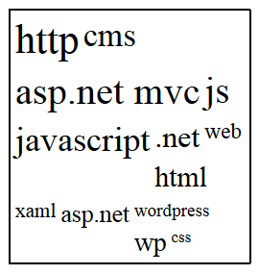
Homework (3)
Create a tag cloud:
Visualize a string of tags (strings) in a given container
By given minFontSize and maxFontSize, generate the tags with different font-size, depending on the number of occurrences
var tags = ["cms", "javascript", "js", "ASP.NET MVC", ".net", ".net", "css", "wordpress", "xaml", "js", "http", "web", "asp.net", "asp.net MVC", "ASP.NET MVC", "wp", "javascript", "js", "cms", "html", "javascript", "http", "http", "CMS"]
var tagCloud = generateTagCloud(tags,17,42);

Slide 39
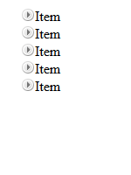
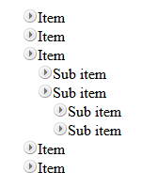
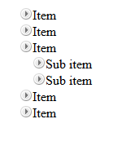
Homework (4)
*Create a TreeView component
Initially only the top items must be visible
On item click
If its children are hidden (collapsed), they must be made visible (expanded)
If its children are visible (expanded), they must be made hidden (collapsed)
Research about events
Initial
Sub item expanded
Top level expanded

